Slide 1

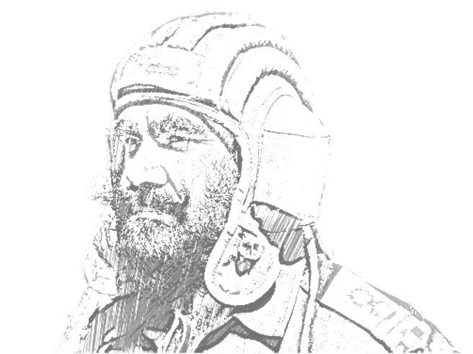
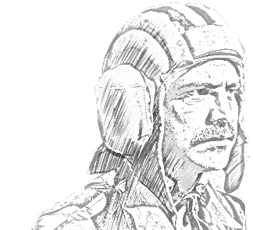
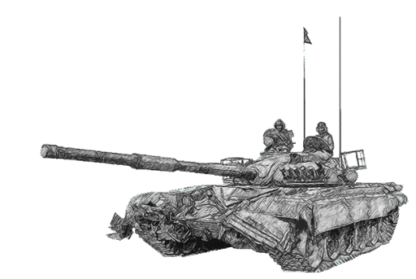
SCHOOL OF TECH TRG
ELECTRONICS & IT WING

Slide 2
AIM
TO AQUAINT THE CLASS ABOUT BASIC TEMINOLOGIES OF WAVE THEORY

Slide 3
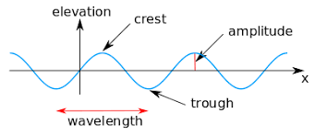
WAVEFORM
Waveform means the shape and form of a signal such as a wave moving in a solid, liquid or gaseous medium.
'Waveform' refers to the shape of a graph of the varying quantity against time or distance. An instrument called an oscilloscope can be used to pictorially represent the wave as a repeating image on a CRT or LCD screen.

Slide 4
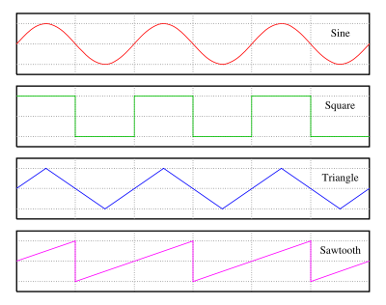
TYPES OF WAVEFORM

Slide 5
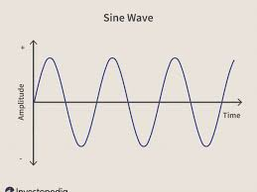
SINE WAVE
Occurs often in mathematics, physics, signal processing, audition, electrical engineering, and many other fields.
It retains its wave shape when added to another sine wave of the same frequency and arbitrary phase.
Graphing the voltage of an alternating current gives a sine wave pattern.

Slide 6
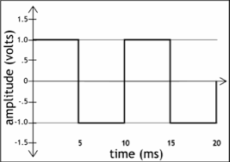
SQUARE WAVE
Non-sinusoidal waveform
Alternates regularly and instantaneously between two levels.
An ideal square wave has instantaneous transitions between the high and low levels.
The times taken for the signal to rise from the low level to the high level and back again are called the rise time and the fall time respectively.
They are used as timing references or "clock signals”.

Slide 7
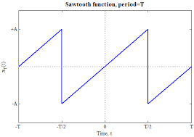
SAWTOOTH WAVE
THE USUAL CONVENTION IS THAT A SAWTOOTH WAVE RAMPS UPWARD AS TIME GOES BY AND THEN SHARPLY DROPS.
HOWEVER, THERE ARE ALSO SAWTOOTH WAVES IN WHICH THE WAVE RAMPS DOWNWARD AND THEN SHARPLY RISES. THE LATTER TYPE OF SAWTOOTH WAVE IS CALLED A 'REVERSE SAWTOOTH WAVE' OR 'INVERSE SAWTOOTH WAVE'. THE ORIENTATIONS OF SAWTOOTH WAVE SOUND IDENTICAL WHEN OTHER VARIABLES ARE CONTROLLED.
OSCILLOSCOPES ALSO USE A SAWTOOTH WAVE FOR THEIR HORIZONTAL DEFLECTION, THOUGH THEY TYPICALLY USE ELECTROSTATIC DEFLECTION.

Slide 8
DO YOU KNOW?
Relation bw Freq & Wavelength?
Low Freq Sound vs High Freq Sound?

Slide 9
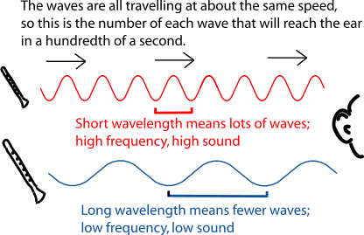
DO YOU KNOW?
Relation bw Freq & Wavelength?
Low Freq Sound vs High Freq Sound?

Slide 10
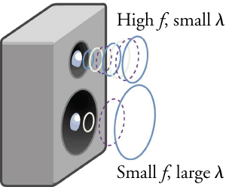
DO YOU KNOW?
How your speakers work?

Slide 11
MODULATION
It is defined as the process of varying the HF carrier wave in accordance with some characteristics of the low freq modulating sig.
OR
It is the process of superimposing a low freq sig over a high freq carrier sig.
OR
The process of varying one of the characteristics (freq /amplitude/phase) of the carrier sig in accordance with the instantaneous amplitude of modulating sig(int).

Slide 12
NEED FOR MODULATION
Practical aerial length .
Mixing of signals or noise.
Poor attenuation and radiation at low freqs.

Slide 13
TYPES OF MODULATION
AMPLITUDE MODULATION
FREQ MODULATION
PHASE MODULATION

Slide 14
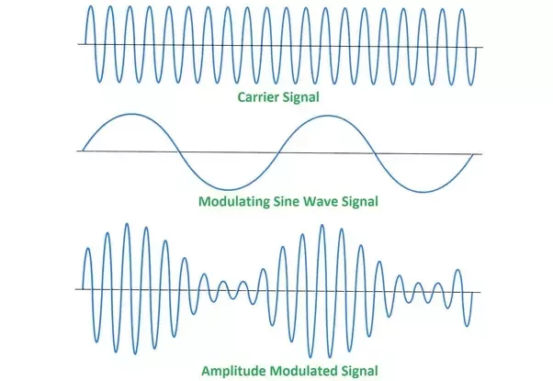
AMPLITUDE MODULATION
When amplitude of HF carrier wave is changed in accordance with the instantaneous amplitude of the modulating sig, freq remaining constant, it is called as amplitude modulation

Slide 15
LIMITATIONS OF AM
Noisy reception.
Low efficiency.
Lack of audio quality.
No of ch are less.

Slide 16
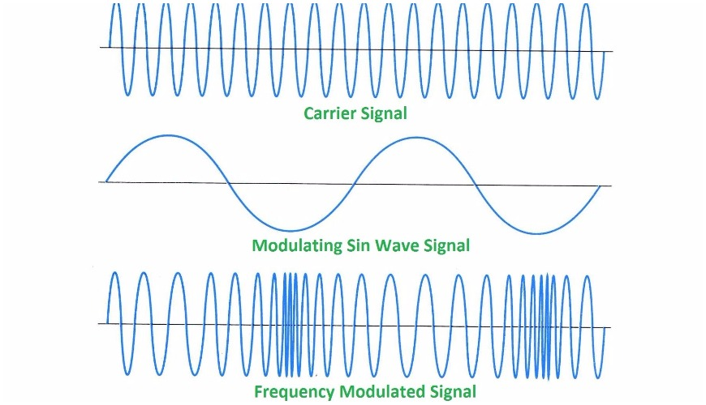
FREQUENCY MODULATION
When the freq of the carrier wave is changed in accordance with the instantaneous amplitude of the modulating sig, amplitude remaining constant the process is called freq modulation (FM).

Slide 17
LIMITATIONS OF FM
A much wider channel (10 times of am ) is reqd for fm txn.
FM tx and rx eqpt tend to be more complex.
Since rxn is ltd to LOS, area of rxn for FM is much smaller.

Slide 18
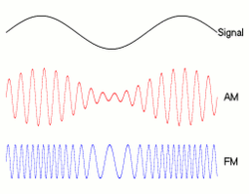
COMPARISION

Slide 19
COMPARISION
Amplitude modulation ( AM ) | Frequency modulation (FM)
AM stands for amplitude modulation. | FM stands for frequency modulation.
This method was first introduced in mid-1870. | FM was introduced in the USA in 1930 by Advin Armstrong.
AM has poor sound quality than FM. | FM has better sound quality than AM.
In AM audio signals changes the amplitude of carrier wave. | In FM, the audio signals change the frequency of a carrier wave.
It affects electrical interference more than FM. | FM is not affected by electrical interference as compared to AM.
AM has a frequency range between 540 – 1600 HZ. | FM has a frequency range of 88 – 108 MHZ.
It has a long-range. | It has a short-range.
AM systems are not immune to noise. | These systems are immune to noise.
In AM only carrier power and one sideband power is useful. | In FM all transmitted power is useful.

Slide 20
MODULATION FACTOR
It is defined as the ratio of max amplitude of the modulating sig to the max amplitude of the carrier sig.
It is a measure to which the carrier sig is varied by the int sig.
M = V_{M}
V_{C}

Slide 21
NOISE
NOISE
INTERNAL
EXTERNAL
-THERMAL AGITATION
-SHOT NOISE
-TRANSMIT TIME NOISE
-MISC NOISE
ATMOSPHERIC
ET NOISE
MAN MADE
SOLAR NOISE
COSMIC NOISE

Slide 22
NOISE
SIG TO NOISE RATIO (S/N). Ratio of sig power to noise power.
S/N = SIG POWER
NOISE POWER
= P_{S}/ P_{N}
NOISE FIGURE. Ratio of sig to noise ratio at the i/p to sig to noise ratio at the o/p of a rxr.

